Slide 1

DAYANANDA SAGAR UNIVERSITY
2019-2020
ADA PROJECT

Slide 2
TOPIC NAME :
URBAN INFRASTRUCTURE DEVELOPMENT PROGRAM

Slide 3
1. Introduction
The problem is a classical NP-hard problem in computer science. It has application in facility location and clustering. Basically, the problem models the following real problem that is given a city with facilities, we find the best facilities where to build fire stations. Since firemen must attend any emergency as quickly as possible, the distance from the farthest facility to its nearest fire station has to be as small as possible. In other words, the position of the fire stations must be such that every possible fire is attended as quickly as possible. This can be done by using DYNAMIC PROGRAMMING.

Slide 4
Dynamic Programming is mainly an optimization over plain recursion. Wherever we see a recursive solution that has repeated calls for same inputs, we can optimize it using Dynamic Programming. The idea is to simply store the results of subproblems, so that we do not have to re-compute them when needed later. This simple optimization reduces time complexities from exponential to polynomial. For example, if we write simple recursive solution for Fibonacci numbers, we get exponential time complexity and if we optimize it by storing solutions of subproblems, time complexity reduces to linear.

Slide 5
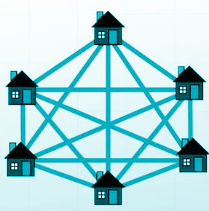
1.1 Problem Statement
Given n cities and distances between every pair of cities, we need to select k cities to place warehouses (or ATMs or Cloud Server) such that the maximum distance of a city to a warehouse (or ATM or Cloud Server) is minimized.

Slide 6
1.2 Objectives
To find the best possible accurate result for maximum inputs.
To provide solution to a problem where maximum distance objects can also access a particular requirement in a minimum length of complexity.
To choose k vertices as centers in a weighted undirected graph in which the edge weights obey the triangle inequality so that the maximum distance of any vertex to its nearest center is minimized.

Slide 7
2. System requirements
2.1 Functional requirements
Get-pip.py : For installing python package libraries.
NetworkX Library : For studying graphs.
MatplotLib Library : Provides an object-oriented API for embedding plots into applications using general-purpose GUI toolkits like Tkinter, wxPython, Qt, or GTK+
Operator Module : Exports a set of efficient functions corresponding to the intrinsic operators.
.txt Reader :TXT files can be opened with the built-in Notepad program in Windows

Slide 8
HARDWARE:
Processor Pentium 4
Hard disk drive 80GB
RAM 256 MB
Cache 512 KB

Slide 9
SOFTWARE:
Language used: Python 3.8
Libraries used : matplotlib.pyplot
Operating system: Ubuntu or Windows 7 and above

Slide 10
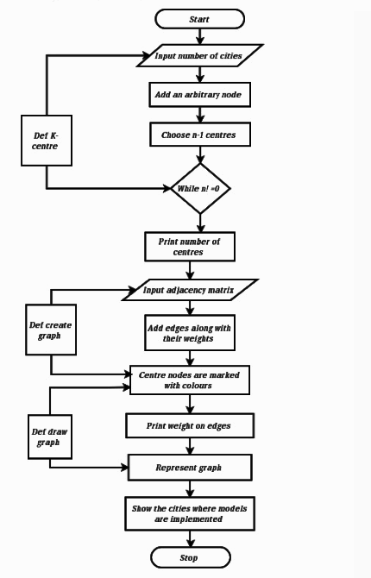
3. System Design
3.1 Architecture/ Data
Flow Diagrams

Slide 11
3.2 MODULES
Networkx : NetworkX is a Python library for studying graphs and networks. NetworkX is a software released under the BSD-new license.
Matplotlib.pyplot : Each pyplot function makes some change to a figure: e.g., creates a figure, creates a plotting area in a figure, plots some lines in a plotting area, decorates the plot with labels, etc.
K_center(g,n) : To find the k centres where the infrastructure can be constructed.

Slide 12
Create graph : To create the original graph of cities with the distance between each in a numerical format.
Input : Its a text file where the inputs for the program are drawn from.
Draw_graph : Function that uses the numerical data to create a visual graph of the kcentres.
Main_function : Main part of the project which connects all the attributes to be called and executed.
Plt.show : plt. show() starts an event loop, looks for all currently active figure objects, and opens one or more interactive windows that display your figure or figures.

Slide 13
4.System implementation
We have many programs that we will interconnect by using them as modules which can be imported
The following are the important programs:
K_ centers module
input module
def Create Graph module
def Draw Graph module
Output graph module

Slide 14
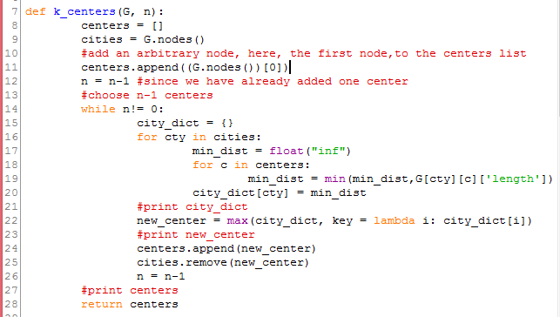
K_CENTERS MODULE :

Slide 15
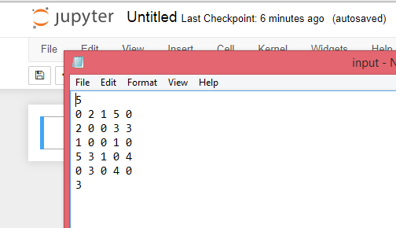
INPUT MODULE:

Slide 16
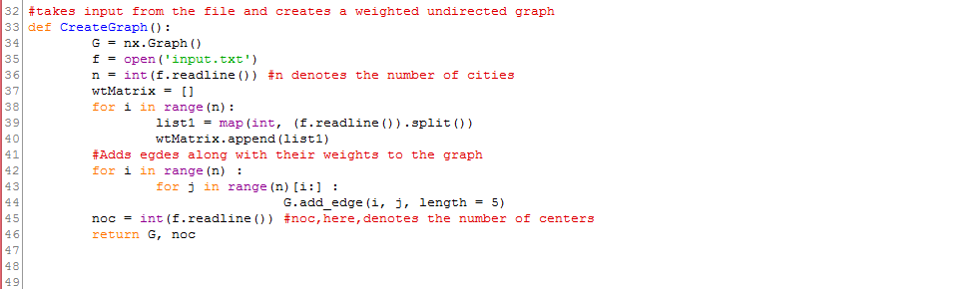
def CREATE GRAPH
MODULE:

Slide 17
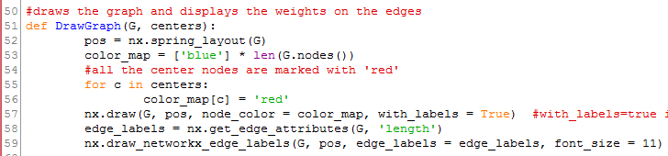
def DRAW GRAPH
MODULE:

Slide 18
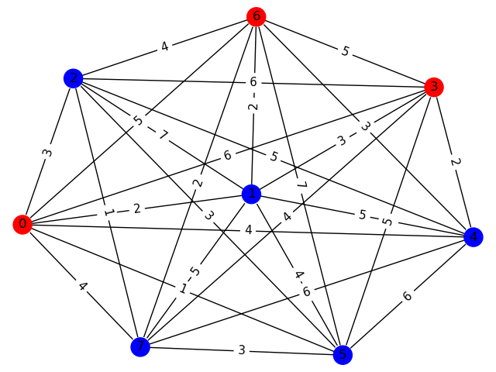
Cities Represented In Graph Format

Slide 19
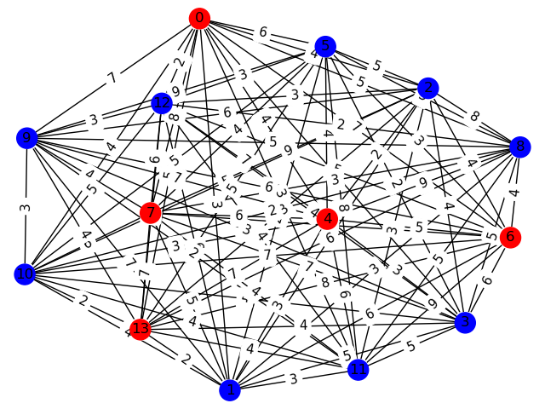
Output Of Program As Highlighted Centres

Slide 20
REFERENCES
https://ieeexplore.ieee.org/document/7408462
https://ieeexplore.ieee.org/abstract/document/1017616 (By Tapas Kanungo ,David M Mount, Nathan S Netanyahu, Christine D Piatko, Ruth Silverman, Angela Y Wu)
https://ieeexplore.ieee.org/document/7367406
https://ieeexplore.ieee.org/document/143543/authors#authors
(By Qingzhou Wang and Kam Hoi Cheng )
https://www.geeksforgeeks.org/k-centers-problem-set-1-greedy-approximate-algorithm/
https://en.wikipedia.org/wiki/Metric_k-center

Slide 21

SUBMITTED BY :
Nikhita A[ENG18CS0192]
Nisha V[ENG18CS0194]
Pavana M[ENG18CS0207]
Pavithra H A[ENG18CS0208]

